Slide 1
Space complexity of recursive vs iterative methods
NAME:- VEMALA CHARAN
REG NO:- 192525271
DEPARTMENT:- AI& ML

Slide 2
INTRUDUCTION
Space complexity is the amount of memory required by an algorithm during execution.
It includes memory used by variables, data structures, and function calls
Recursive algorithms require additional memory for the call stack
Comparing both methods helps in selecting the most efficient solution.

Slide 3
ALGORITHM
Algorithm 1: Recursive Factorial
Input: Integer n
Output: Factorial of n
Start.
Read integer n.
If n == 0 or n == 1, return 1.
Otherwise, return n × Factorial(n-1).
Stop.

Slide 4
Algorithm 2: Iterative Factorial
Output: Factorial of n
Start.
Read integer n.
Initialize result = 1.
Repeat from i = 1 to n.
Multiply result = result × i.
Input: Integer n
Display result.
Stop.

Slide 5
ARCHITECTURE DESIGN:-
Recursive Method
Main Program
|
V
Recursive Function
|
V
+------------------+
| Factorial(5) |
| Factorial(4) |
| Factorial(3) |
| Factorial(2) |
| Factorial(1) |
+------------------+
(Call Stack)

Slide 6
ALTERATIVE METHOD:-
Main Program
|
V
Loop (for)
|
V
+------------------+
| n |
| result |
| i |
+------------------+
(Constant Memory)

Slide 7
IMPLEMENTATION CODE:-
Implementation Code
Recursive (Python)
def factorial_recursive(n):
if n == 0 or n == 1:
return 1
return n * factorial_recursive(n - 1)
print(factorial_recursive(5))
Output
120

Slide 8
ITERATIVE PYTHON:-
def factorial_iterative(n):
result = 1
for i in range(1, n + 1):
result *= i
return result
print(factorial_iterative(5))
Output
120

Slide 9
COMPLEXITY ANALYSIS:-
FETURE | RECURSIVE | ITERATIVE
TIME COMPLEXITY | O(n) | O(n)
SPACE COMPLEXITY | O(n) | O(1)
STACK USAGE | USES CALL STACK | No call stack
MEMORY REQUIREMENT | HIGH | low

Slide 10
Memory Comparison:- Recursive: Stores every function call in memory. F(5) F(4) F(3) F(2) F(1) Space = O(n)
Iterative: Uses only a few variables.
result
i
n
Space = O(1)

Slide 11
Conclusion:-
Both recursive and iterative methods have O(n) time complexity. However, recursion requires O(n) space because of the call stack, while iteration requires only O(1) extra space.
Therefore, the iterative method is preferred when memory efficiency is important, whereas recursion is useful for problems that are naturally recursive.

Slide 12
References
Thomas H. Cormen et al., Introduction to Algorithms.
Ellis Horowitz & Sartaj Sahni, Fundamentals of Data Structures.
Python Documentation – https://docs.python.
org⁠�GeeksforGeeks – https://www.geeksforgeeks.org⁠�

Slide 13
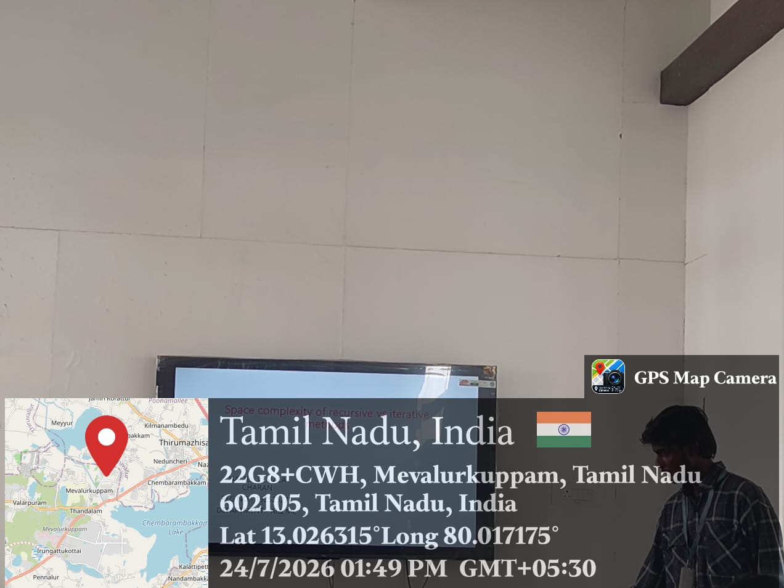

Slide 14
THANK YOU

